Slide 1
Ammonia Removal using Transmembrane Chemisorption (TMCS)
Membrane Performance Study
Rajesh Rajendran
29/07/2025

Slide 2
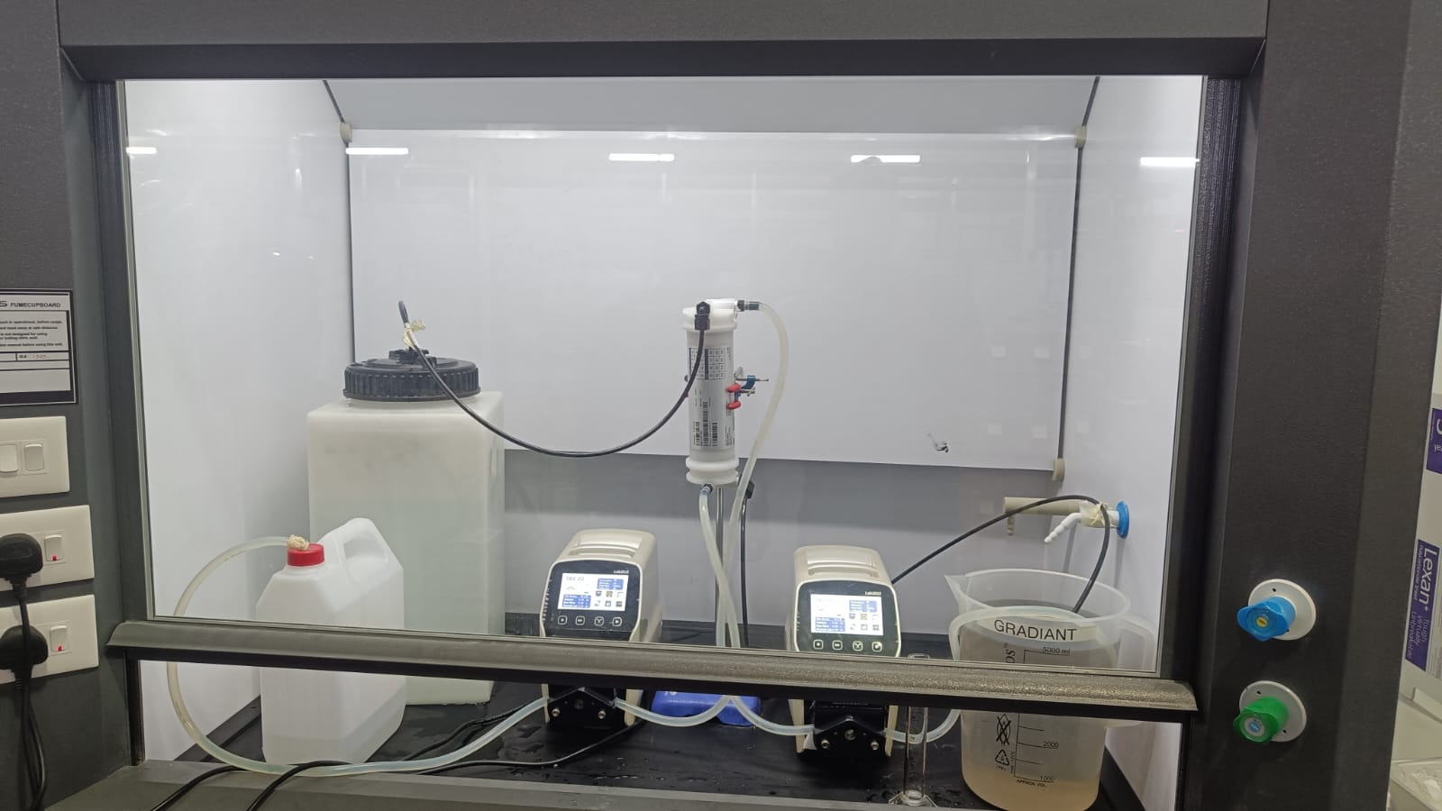
Experimental Setup
Membrane Cell
spent Ammonia
Sulphuric Acid
Ammonia soln (~750ppm)
Pump
Pump

Slide 3
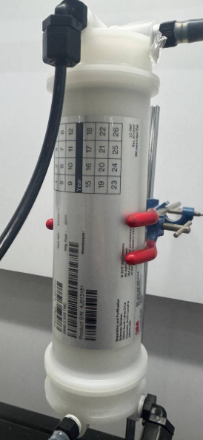
List of Equipment
Membrane cell: 3M G940 2.5x8 TMC
Peristaltic Pump: Lab2015 YZ1515x
Flexible Tubing: Silicone Hose #18
Hard Tubing: Semi-Rigid Nylon ¼”

Slide 4
Experimental Procedure
Prepared fixed concentration of 11.1 Normal sulfuric acid of 5L volume.
Prepared a fixed concentration of ~754ppm ammonium hydroxide of 35L
The pH of the Ammonium solution should be > pH 10 (if pH <10 adjust by adding NaOH).
Carried out the experiment at a flow rate of 380ml/min in both shell and gas side .
Sulphuric acid is recirculated for absorbing the Ammonia
Ammonium hydroxide solution is single pass and spent ammonia is collected in separate tank
Collected the samples at intervals of 15min and taken for the analysis (change in Nitrogen)
Ammonia is indicated by Nitrogen concentration, measured using TOC analyser

Slide 5
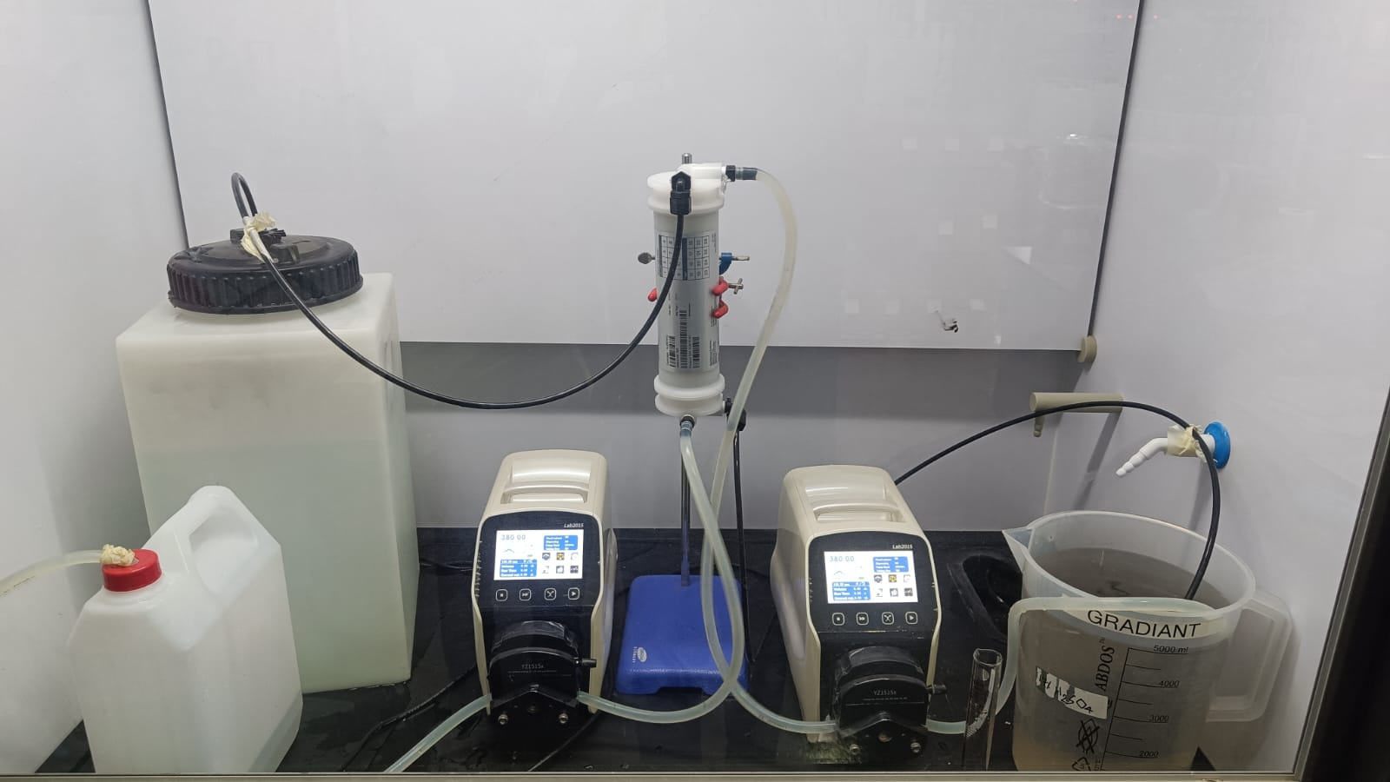
Experimental Photos – Start & End
Start of Experiment
End of Experiment

Slide 6
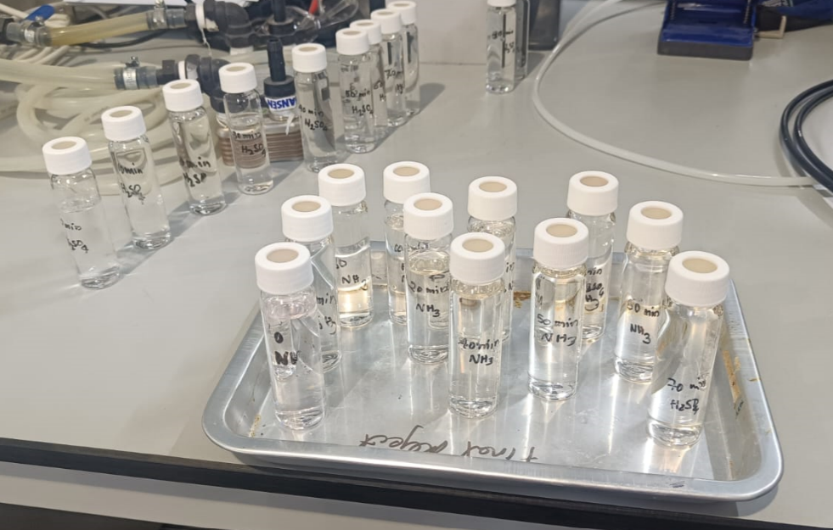
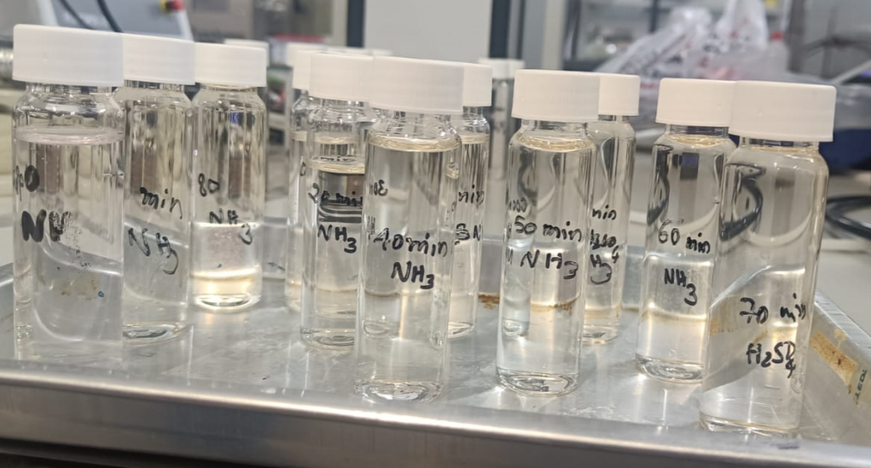
Samples Collected

Slide 7
Experimental Results
Batches of 5 5 Lt | Reduction of NH4OH in ppm
Batch 1 | 139.1
Batch 2 | 97.9
Batch 3 | 136.5
Batch 4 | 148.1
Batch 5 | 39.9
Batch 6 | 48.9
Batch 7 | 68.3

Slide 8
Observations
Initial and final volume of Sulphuric acid has not changed.
Colour of the sulphuric acid turned to black from colorless
Initial concentration of acid 11.1N
Final concentration of acid reduced to 9.3N
Final concentration of Ammonium sulphate solution in sulphuric acid is increased from 75ppm to 13566 ppm
Future Plan:
I would like to study the effect of increasing the concentration of ammonia solution at different levels, while keeping the concentration of sulfuric acid fixed.

